Slide 1
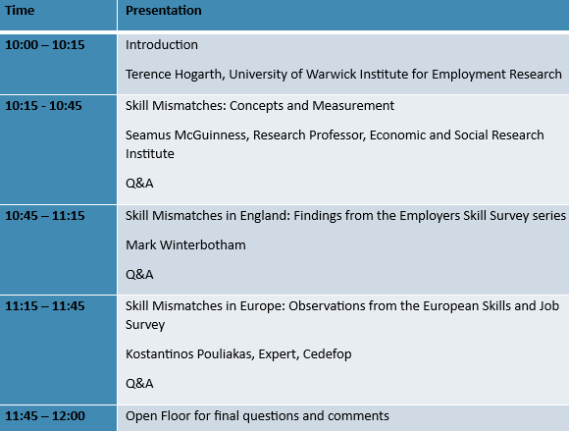
The Current State of Skill Mismatches: Employer and Employee Perspectives
10:00 – 12:00 (GMT), 28th February 2024
Thank you for joining todays LMI for All webinar. Please note that this webinar will be recorded.
For any questions outside this webinar, we can be contacted via lmiforall@warwick.ac.uk
Other webinar dates:
21 March 2024 – 1-3pm - Entrepreneurship skills
7 May 2024 – 10am – 12pm - Predicting future skill needs
Sign up to our mailing list for LMI for All or follow us on social media: https://warwick.ac.uk/fac/soc/ier/researchthemesoverview/researchprojects/lmi_for_all/dissemination/
X LinkedIn
@LMIforAll
https://www.linkedin.com/in/lmi-for-all-41984427a/

